Slide 1


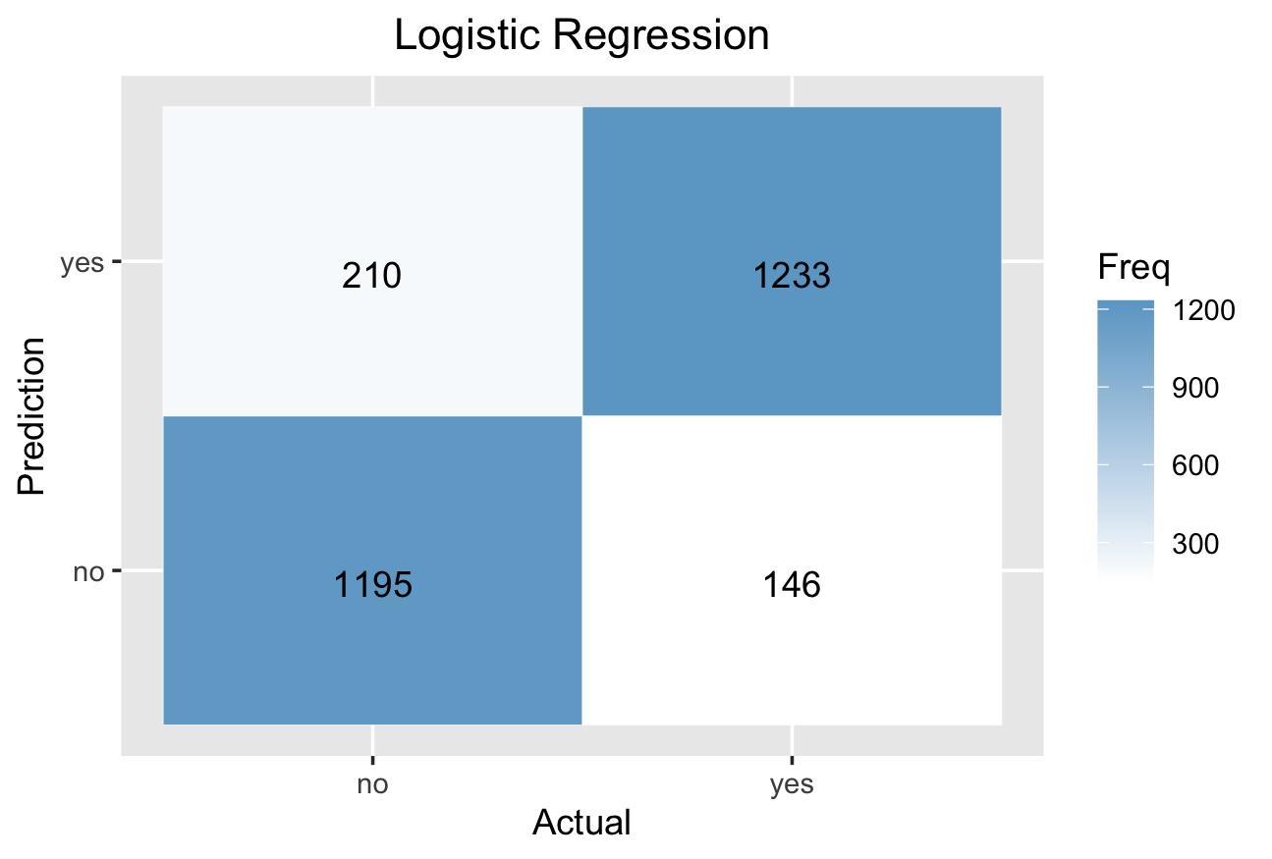
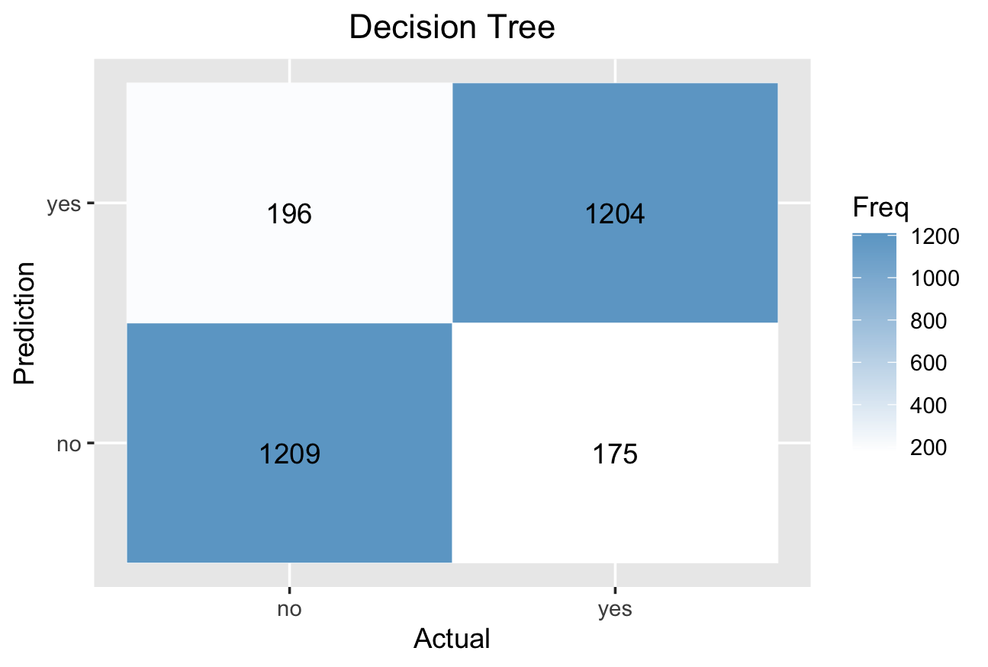
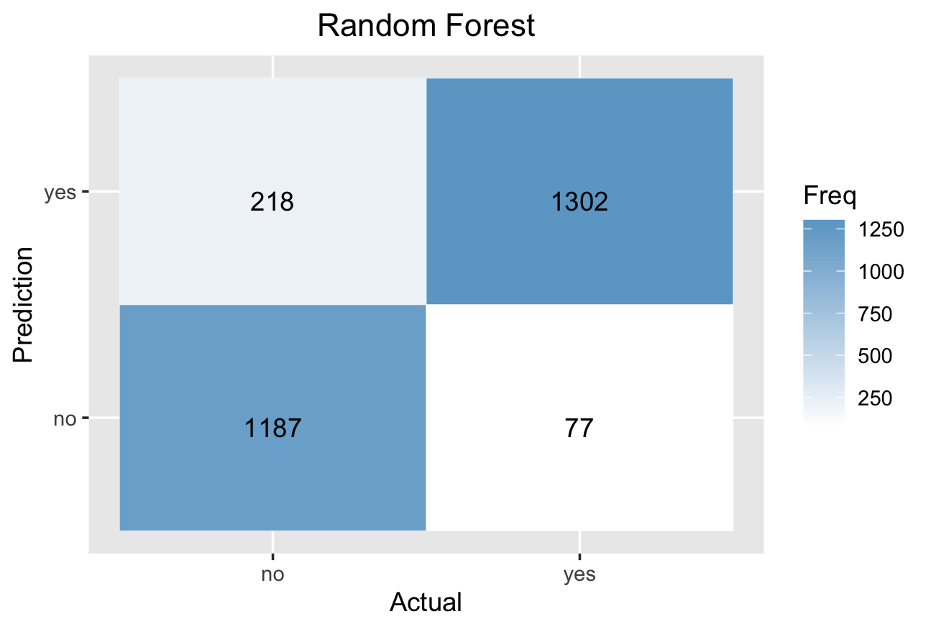

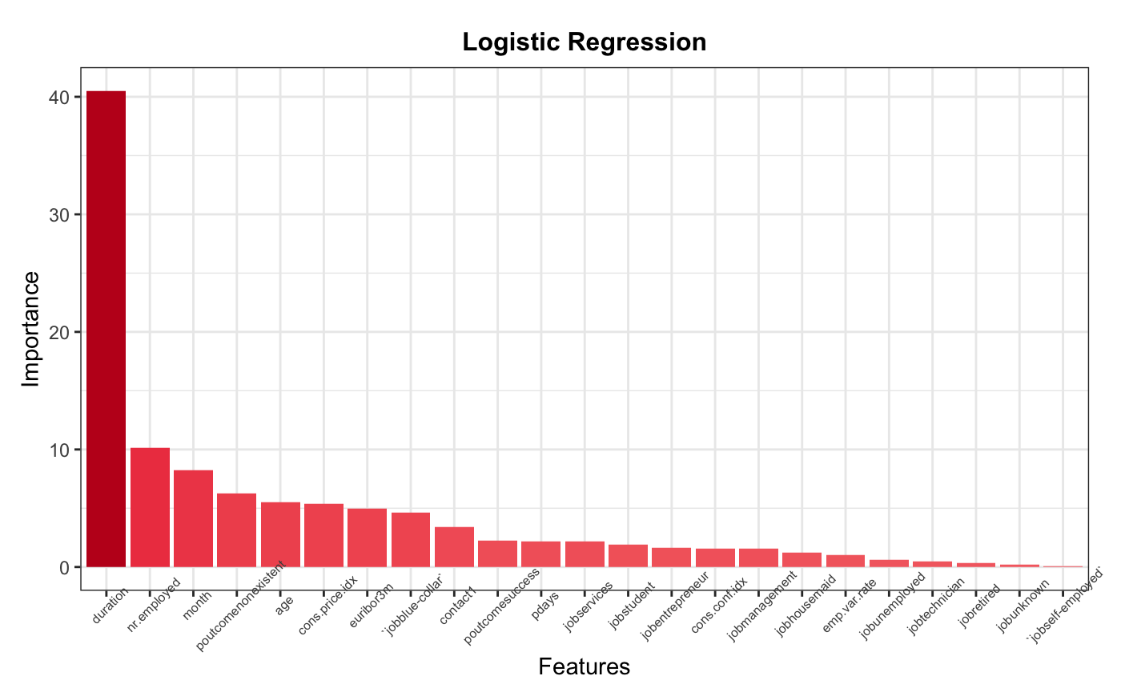
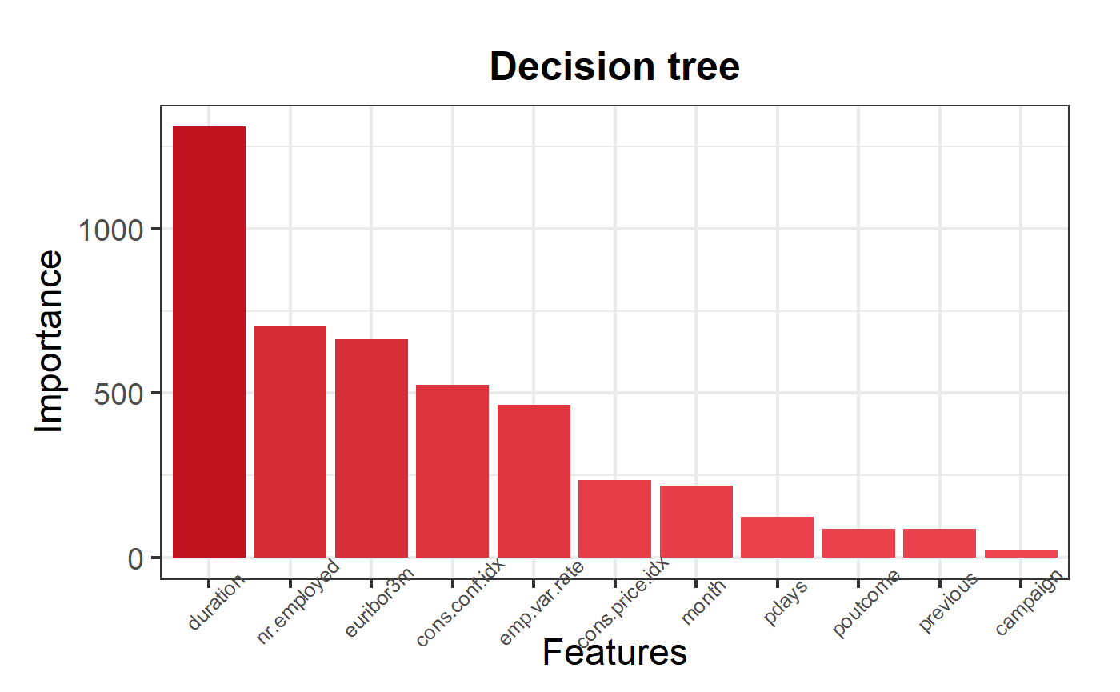
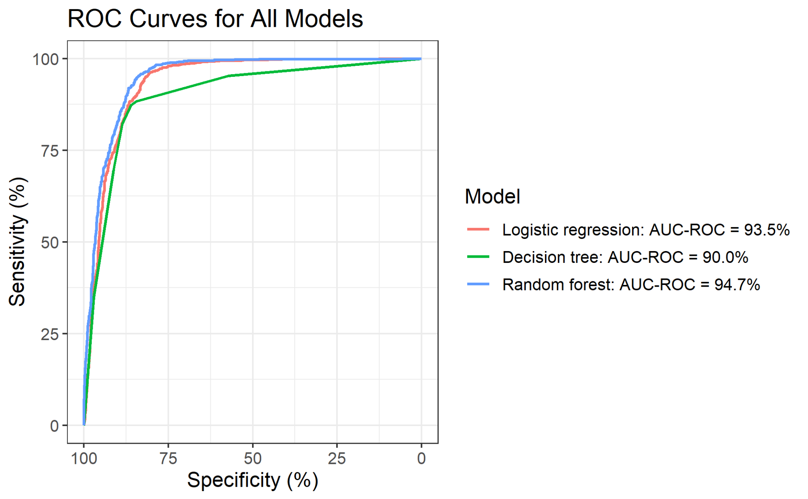
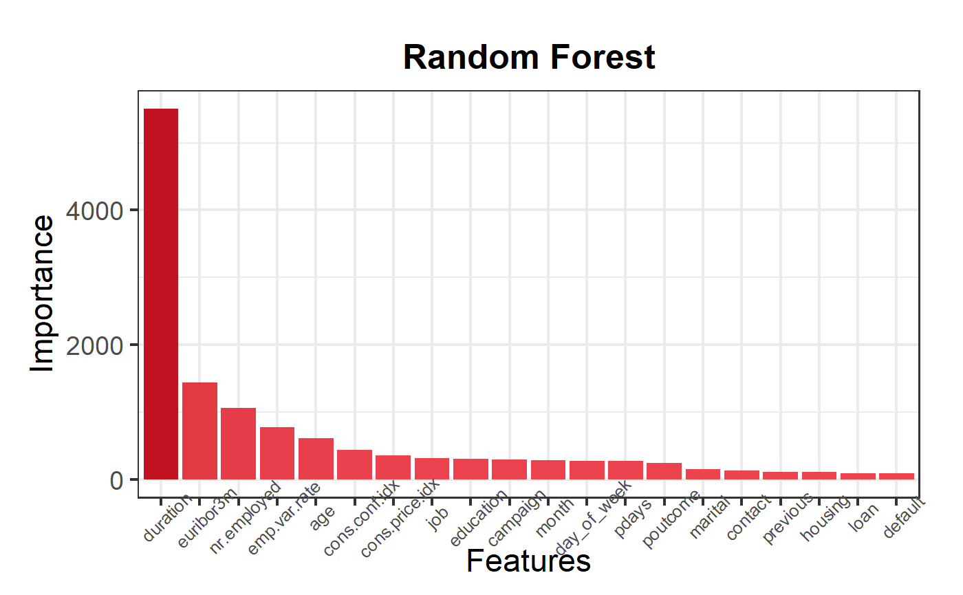
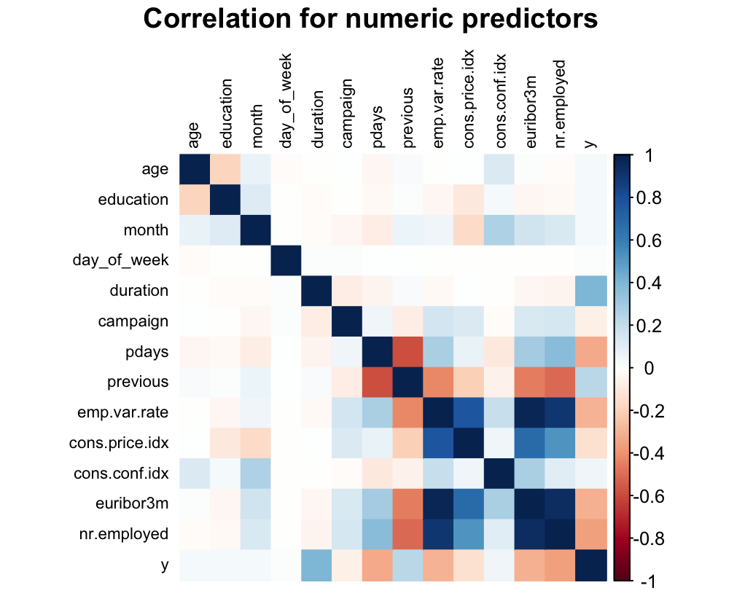
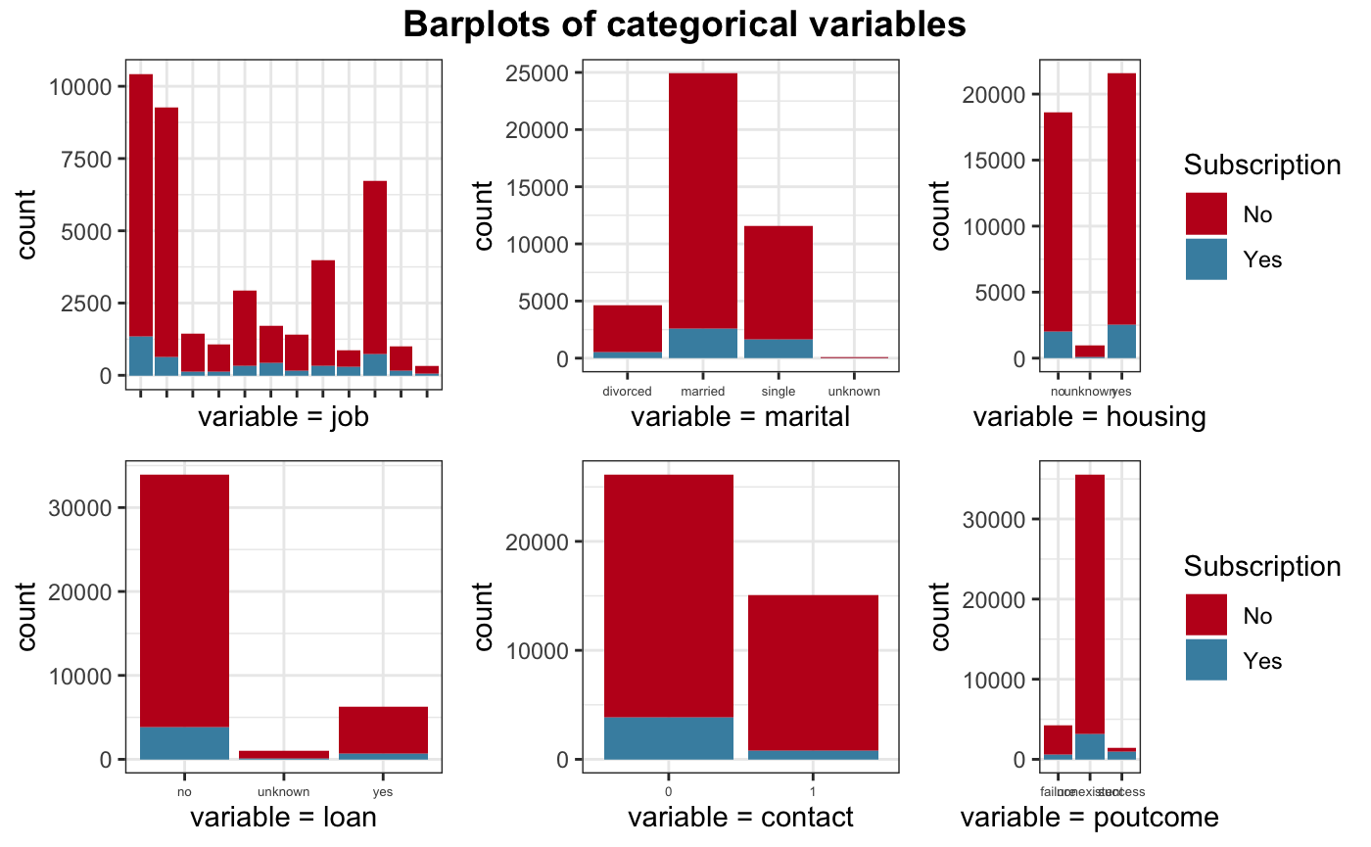
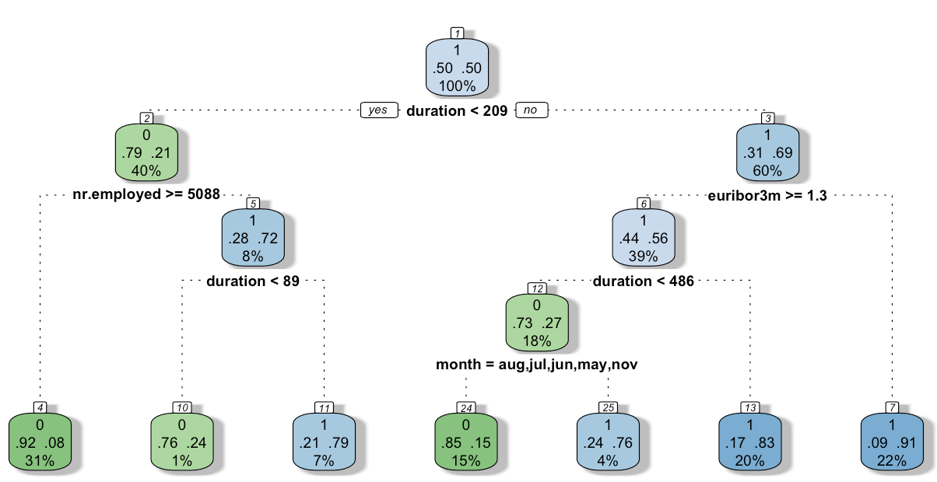
Bank Marketing Analysis: Term Deposit Cold Call Prediction
Zheyuan Hu, Hanming Li, Jiaqi Song
Georgetown University, Data Science and Analytics Program
Introduction
Model Summary
Model Evaluation - Confusion Matrix
Cold call has a long history in bank marketing because of its effectiveness. Bankers and salesman have been told their entire life that cold calling is how a business gains traction and develops a sizable customer base. But a constant limitation of the cold call is it is a rather low successful rate. Only about 28% cold calls result in a conversion and even 2% of cold calls are successful. That can be improved by data analysis.
Hyperparameter Tuning
The problems we want to solve:
-1. Can we predict if a client will subscribe to a term deposit?
-2. What strategies can we use to get a client subscription?
-3. How much of time should a cold call last?
-4. Can we build a scorecard for bank client based on their information?
Data Cleaning
Model
Evaluation
Three
Model
Fitting
Dataset
Data
Resampling
Outcome
Visualization
Confusion matrix for each model was plotted in order to show the difference in performance. The color closed to white represents a smaller frequency, while that closed to deep blue represents a larger frequency. Overall, all of three models produce convincing predictions, but further evaluation should be conducted for more accurate comparisons.
The data contains marketing information collected by direct phone calls to evaluate whether clients subscribe to a bank term deposit for a Portuguese banking institution.
Variable Introduction
Feature Importance
Model Evaluation - ROC & AUC
Demographics:
- age: Customer's age (numeric)
- job: Type of job
- marital: Marital status
- education: Level of education
Past customer events:
- housing: Has housing loan?
- loan: Has personal loan?
Past direct marketing contacts:
- contact: Contact communication type
- month: Last contact month of year
- dayofweek: Last contact day of the week
- duration: Last contact duration, in seconds (numeric).
Campaign information:
- campaign: Number of contacts performed during this campaign and for this client
- pdays: Number of days that passed by after the client was last contacted from a previous campaign (numeric)
- previous: Number of contacts performed before this campaign and for this client (numeric)
- poutcome: Outcome of the previous marketing campaign
Socioeconomic factors:
- emp.var.rate: Employment variation rate
- cons.price.idx: Consumer price index
- cons.conf.idx: Consumer confidence index
- euribor3m: Euribor 3 month rate
- nr.employed: Employment rate
Table 1: Models summary
Model | Accuracy | Kappa | AUC
LR | 0.872 | 0.744 | 0.935
DT | 0.869 | 0.737 | 0.900
RF | 0.900 | 0.790 | 0.947
The table above summarizes the evaluation results of the three models. Considering three essential criteria: accuracy, kappa and auc, random forest has the best performance in every field.
Top 3 important features for each model:
- LR: duration, nr.employed, month
- DT: duration, nr.employed, euribor3m
- RF: duration, euribor3m, nr.employed
Overall, the most significant features are:
duration, nr.employed, euribor3m, month.
Target variable: y - has the client subscribed a term deposit? (binary: "yes","no")
Model Evaluation - Analysis
To give a good prediction for clients’ subscription, three supervised learning models are trained respectively using balanced undersampling data. For the test dataset, three criteria are applied to evaluate the predicting results.
To sum up, Random Forest is the best among the three models with the highest AUC-ROC score of 94.7%. The weighted model counters data imbalance well. Logistic Regression has the second higher accuracy and Kappa. Its AUC is slightly lower than Random Forest. This model still faces an imbalance problem in spite of resampling. Decision Tree is the worst one with the lowest accuracy and Kappa. Its AUC is much lower than the other models.
This summary shows that a single tree is not sufficient in producing effective result with this dataset. The application of ensemble learning, which combines the output of multiple trees in order to generate the final output, highly improves the performance of a single decision tree.
Data Visualization
Modeling Pipeline
Logistic Regression:
1. Compare the Information Value and drop the features with low IV.
2. Apply WOE on some of the variables.
3. Fitting and comparing.
Decision Tree:
1. Find the best value of cp by cross-validation
2. Pruning the tree using the best value of cp
Random Forest:
1. Find optimal mtry and ntree via iteration
2. Apply weights to the training set based on data imbalance in y
3. Fit the model
Conclusion
During modeling, it is discovered that duration, nr.employed, euribor3m, and month are the most important factors that correlate with whether the client will subscribe to the bank term deposit or not. In other words, it is a good strategy to prolong the duration. The longer the duration of your calling, the higher possibility that you have to succeed. Most of the successful cases have a duration around 8 minutes. Moreover, during the period that has a lower employment rate, the client will be more likely to subscribe a term deposit. Additionally, since the logistic regression produces a simple linear relationship, a scoreboard is also workable for building up a client base.
Figure 1: Distribution of categorical variables with subscription
Figure 2: Correlation heatmap of numeric variables

